Slide 1
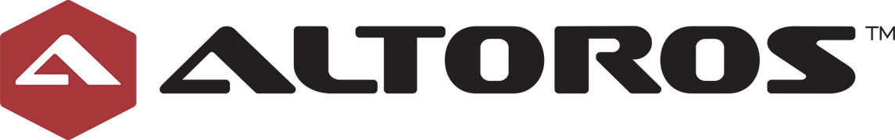
Cloud Foundry introduction

Slide 2
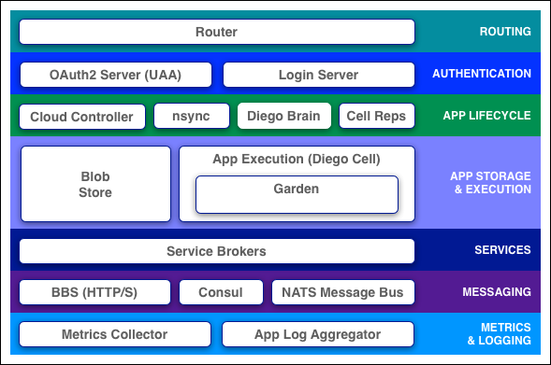
Components
Cloud Foundry components include a self-service application execution engine, an automation engine for application deployment and lifecycle management, and a scriptable command line interface (CLI), as well as integration with development tools to ease deployment processes. Cloud Foundry has an open architecture that includes a buildpack mechanism for adding frameworks, an application services interface, and a cloud provider interface.
Notes:
goal:
single platform for all devices
Increase quality and reduce the amount of stabilization
reduce planning.
PaaS is good fit for Project automatization
tests should be small.

Slide 3
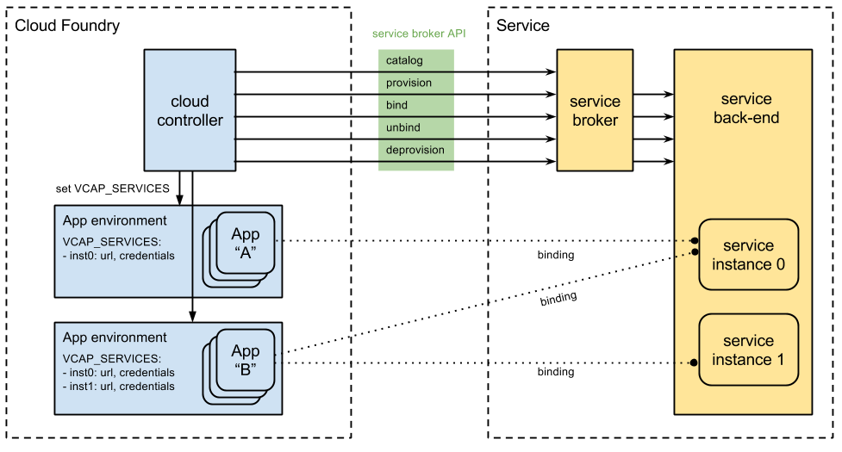
Service Broker
Notes:
goal:
single platform for all devices
Increase quality and reduce the amount of stabilization
reduce planning.
PaaS is good fit for Project automatization
tests should be small.

Slide 4
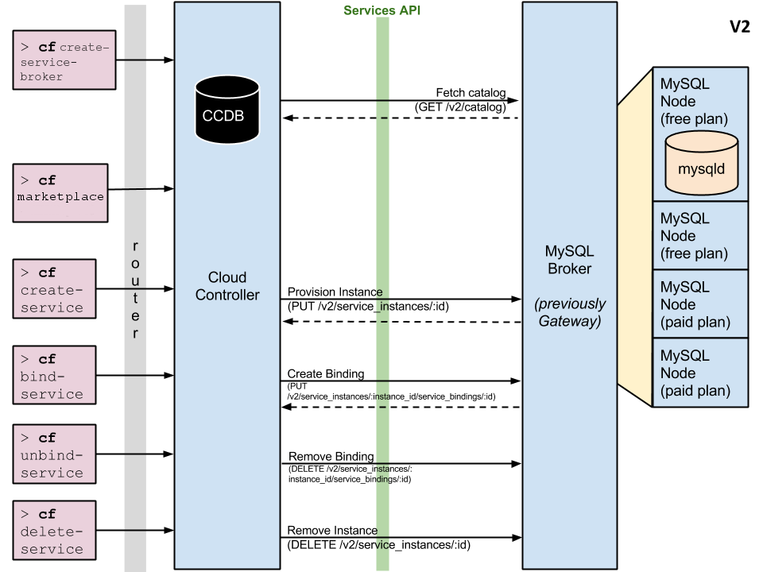

Slide 5
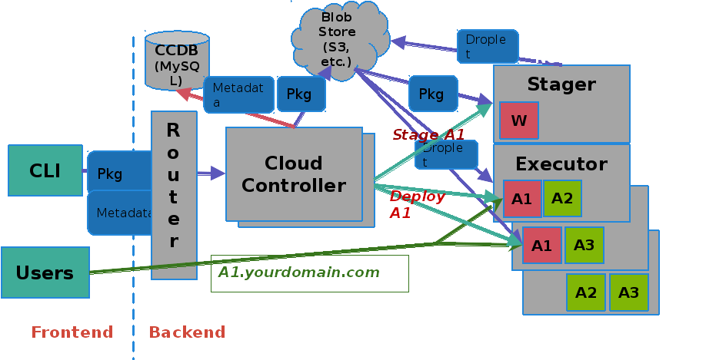
> cf push = deploy
Notes:
goal:
single platform for all devices
Increase quality and reduce the amount of stabilization
reduce planning.
PaaS is good fit for Project automatization
tests should be small.

Slide 6
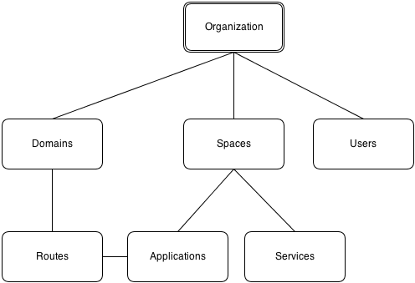
Orgs, Spaces, Quotas & Users
Organizations: An organization is the top-most meta object within the Cloud Foundry infrastructure.
Spaces: An organization can contain multiple spaces. The defaults for a standard Cloud Foundry install are development, test, and production.
Domains: A domain is a domain-name like acme.com or foo.net.
Routes: A route, based on a domain with an optional host as a prefix, may be associated with one or more applications.
Notes:
goal:
single platform for all devices
Increase quality and reduce the amount of stabilization
reduce planning.
PaaS is good fit for Project automatization
tests should be small.

Slide 7
OSS Cloud Foundry
IBM BlueMix
Community Maintained
Releases are pushed often, standard testings.
No services out of the box
Everything is managed by your team
No out of the box UI
Standard, community provided toolchain
Free
Maintained and supported by IBM
Based on Open Source
Thoroughly tested before releases are deployed in production
Broad offering of services out of the box:
Databases (RDBMS, NoSQL)
Queue management
Business rules
Caching
Auto-scaling
Watson ecosystem
Everything can be managed by IBM
Customized, great UI included
Community/Proprietary mix of tools
Paid license

